Slide 1

Python for Data Analysts
Morgan McKnight

Slide 2
What I will be covering
What is Python and why is it so popular?
What are Jupyter Notebooks and who uses them?
Examples of Jupyter Notebooks (Fintech, Covid, property_prices)
Python for Data Analysts, Diploma course
Notes:
LP optimisation to increase conversion % - some low performing LPs on mobile, new design layout, UX review has taken place
Go-to Marketing for programme portfolio – some programmes were deprioritised whilst we were ramping up lead volumes for our top sellers

Slide 3
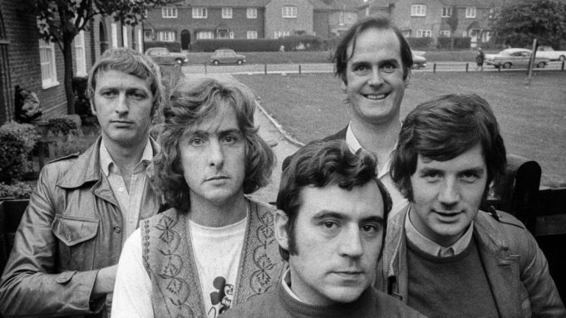
Python Philosophy
Simple is better than complex.
Beautiful is better than ugly.
Explicit is better than implicit.
Complex is better than complicated
Readability Counts

Slide 4
Who uses in Python?
Instagram is built in Python.
It is one of the three official languages used by Google engineers.
Netflix uses Python to power its data analysis on the server side.
Dropbox uses Python for its desktop client.
Reddit is coded in Python.

Slide 5
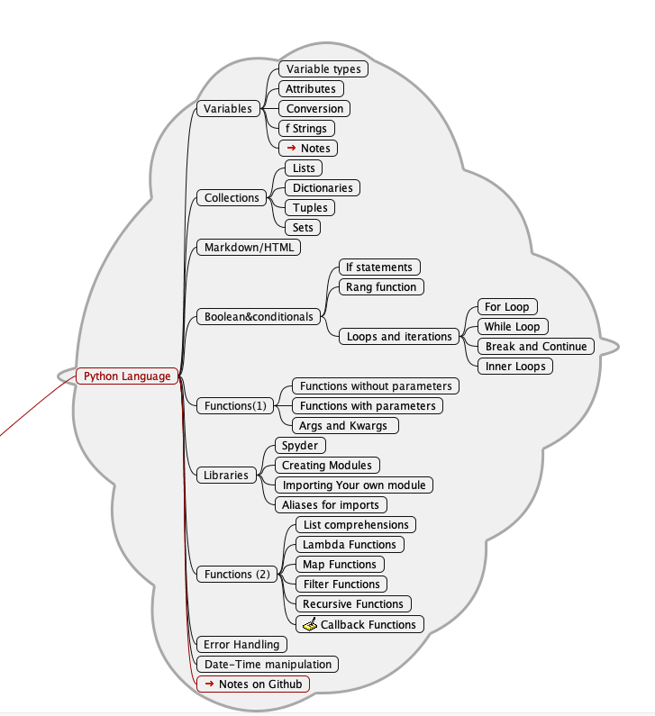

Course Outline (1)

Slide 6
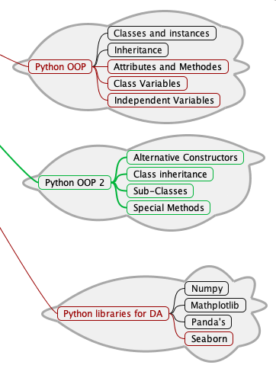
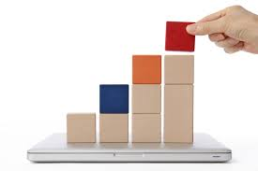
Course Outline (2)

Slide 7
Assignments
Assignment 1 (week 6)
Assignment 2 (week 11)
To create a program with two turtles that draw on the screen and interact with each other. (You are free to interpret this as you like.)
To either download a dataset from the internet e.g. weather data, or use suitable data from your workplace, and using Python, Pandas and Matplotlib, analyze the data and display the results in a table and graph.
(You should have some statistical calculations such as mean, max min in your analyses )

Slide 8

Example Lesson 9
Let’s Go!

